Slide 1
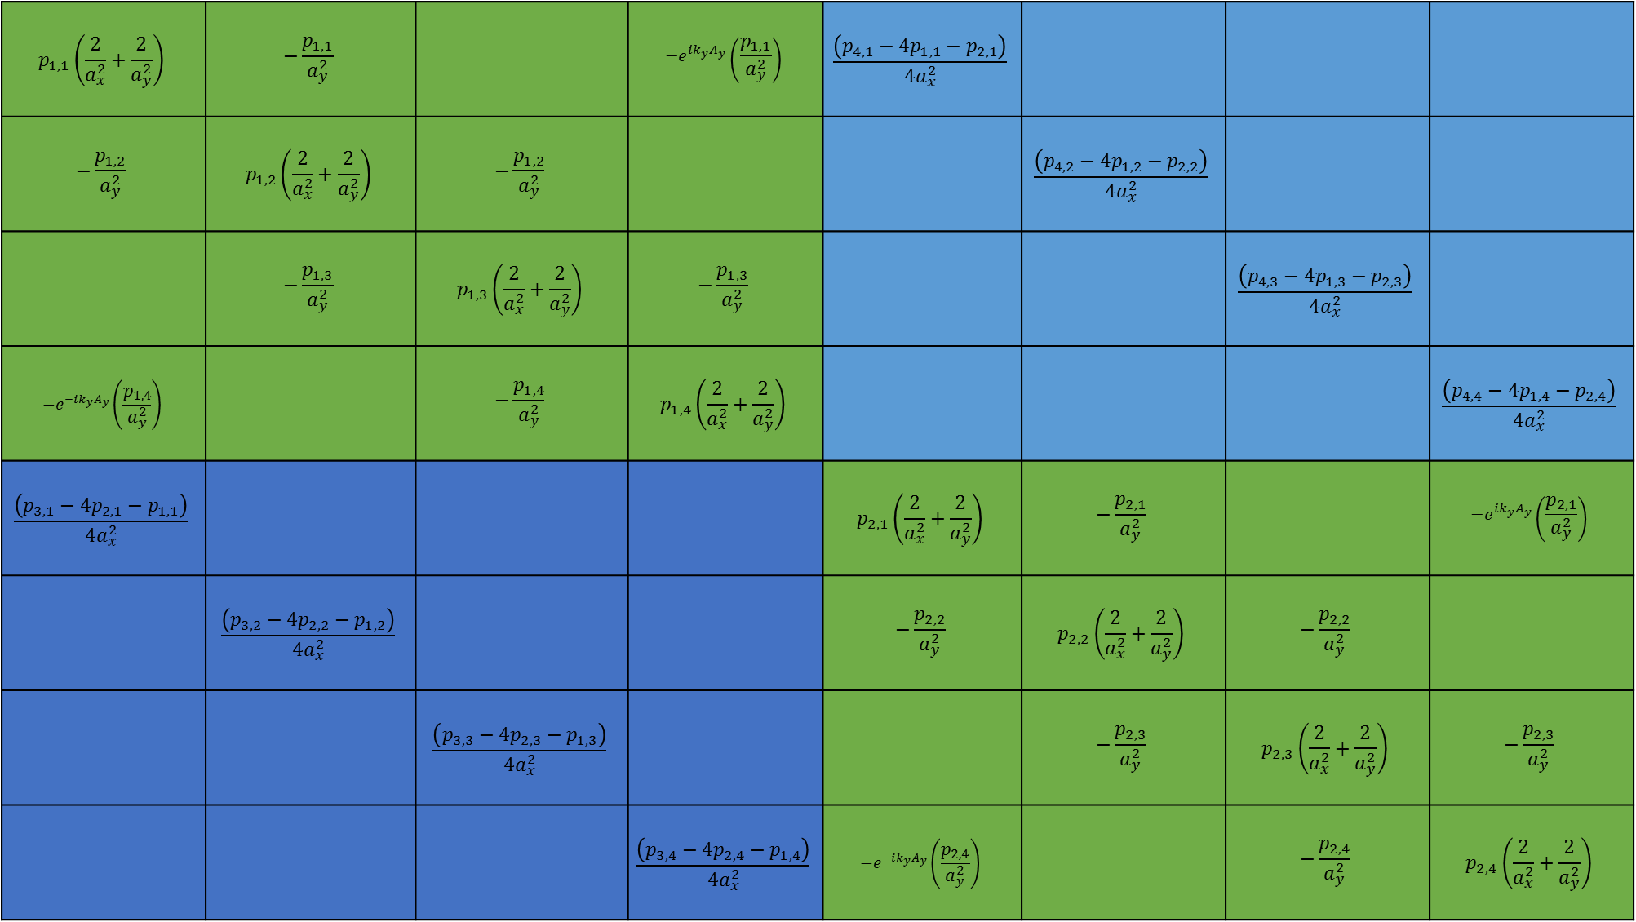
(1, 1)
(1, 2)
(1, 3)
(1, 4)
(1, 5)
(1, 6)
(1, 7)
(1, 8)
$$p_{1,1}\left(\frac{2}{a_{x}^{2}}+\frac{2}{a_{y}^{2}}\right)$$ | $$−\frac{p_{1,1}}{a_{y}^{2}}$$ |  | $$−e^{ik_{y}A_{y}}\left(\frac{p_{1,1}}{a_{y}^{2}}\right)$$ | $$\frac{\left(p_{4,1}−{4p}_{1,1}−p_{2,1}\right)}{{4a}_{x}^{2}}$$
$$−\frac{p_{1,2}}{a_{y}^{2}}$$ | $$p_{1,2}\left(\frac{2}{a_{x}^{2}}+\frac{2}{a_{y}^{2}}\right)$$ | $$−\frac{p_{1,2}}{a_{y}^{2}}$$ |  |  | $$\frac{\left(p_{4,2}−{4p}_{1,2}−p_{2,2}\right)}{{4a}_{x}^{2}}$$
 | $$−\frac{p_{1,3}}{a_{y}^{2}}$$ | $$p_{1,3}\left(\frac{2}{a_{x}^{2}}+\frac{2}{a_{y}^{2}}\right)$$ | $$−\frac{p_{1,3}}{a_{y}^{2}}$$ |  |  | $$\frac{\left(p_{4,3}−{4p}_{1,3}−p_{2,3}\right)}{{4a}_{x}^{2}}$$
$$−e^{−ik_{y}A_{y}}\left(\frac{p_{1,4}}{a_{y}^{2}}\right)$$ |  | $$−\frac{p_{1,4}}{a_{y}^{2}}$$ | $$p_{1,4}\left(\frac{2}{a_{x}^{2}}+\frac{2}{a_{y}^{2}}\right)$$ |  |  |  | $$\frac{\left(p_{4,4}−{4p}_{1,4}−p_{2,4}\right)}{{4a}_{x}^{2}}$$
$$\frac{\left(p_{3,1}−{4p}_{2,1}−p_{1,1}\right)}{{4a}_{x}^{2}}$$ |  |  |  | $$p_{2,1}\left(\frac{2}{a_{x}^{2}}+\frac{2}{a_{y}^{2}}\right)$$ | $$−\frac{p_{2,1}}{a_{y}^{2}}$$ |  | $$−e^{ik_{y}A_{y}}\left(\frac{p_{2,1}}{a_{y}^{2}}\right)$$
 | $$\frac{\left(p_{3,2}−{4p}_{2,2}−p_{1,2}\right)}{{4a}_{x}^{2}}$$ |  |  | $$−\frac{p_{2,2}}{a_{y}^{2}}$$ | $$p_{2,2}\left(\frac{2}{a_{x}^{2}}+\frac{2}{a_{y}^{2}}\right)$$ | $$−\frac{p_{2,2}}{a_{y}^{2}}$$
 |  | $$\frac{\left(p_{3,3}−{4p}_{2,3}−p_{1,3}\right)}{{4a}_{x}^{2}}$$ |  |  | $$−\frac{p_{2,3}}{a_{y}^{2}}$$ | $$p_{2,3}\left(\frac{2}{a_{x}^{2}}+\frac{2}{a_{y}^{2}}\right)$$ | $$−\frac{p_{2,3}}{a_{y}^{2}}$$
 |  |  | $$\frac{\left(p_{3,4}−{4p}_{2,4}−p_{1,4}\right)}{{4a}_{x}^{2}}$$ | $$−e^{−ik_{y}A_{y}}\left(\frac{p_{2,4}}{a_{y}^{2}}\right)$$ |  | $$−\frac{p_{2,4}}{a_{y}^{2}}$$ | $$p_{2,4}\left(\frac{2}{a_{x}^{2}}+\frac{2}{a_{y}^{2}}\right)$$
(2, 1)
(2, 2)
(2, 3)
(2, 4)
(2, 5)
(2, 6)
(2, 7)
(2, 8)
(3, 1)
(3, 2)
(3, 3)
(3, 4)
(3, 5)
(3, 6)
(3, 7)
(3, 8)
(4, 1)
(4, 2)
(4, 3)
(4, 4)
(4, 5)
(4, 6)
(4, 7)
(4, 8)
(5, 1)
(5, 2)
(5, 3)
(5, 4)
(5, 5)
(5, 6)
(5, 7)
(5, 8)
(6, 1)
(6, 2)
(6, 3)
(6, 4)
(6, 5)
(6, 6)
(6, 7)
(6, 8)
(7, 1)
(7, 2)
(7, 3)
(7, 4)
(7, 5)
(7, 6)
(7, 7)
(7, 8)
(8, 1)
(8, 2)
(8, 3)
(8, 4)
(8, 5)
(8, 6)
(8, 7)
(8, 8)

Slide 2
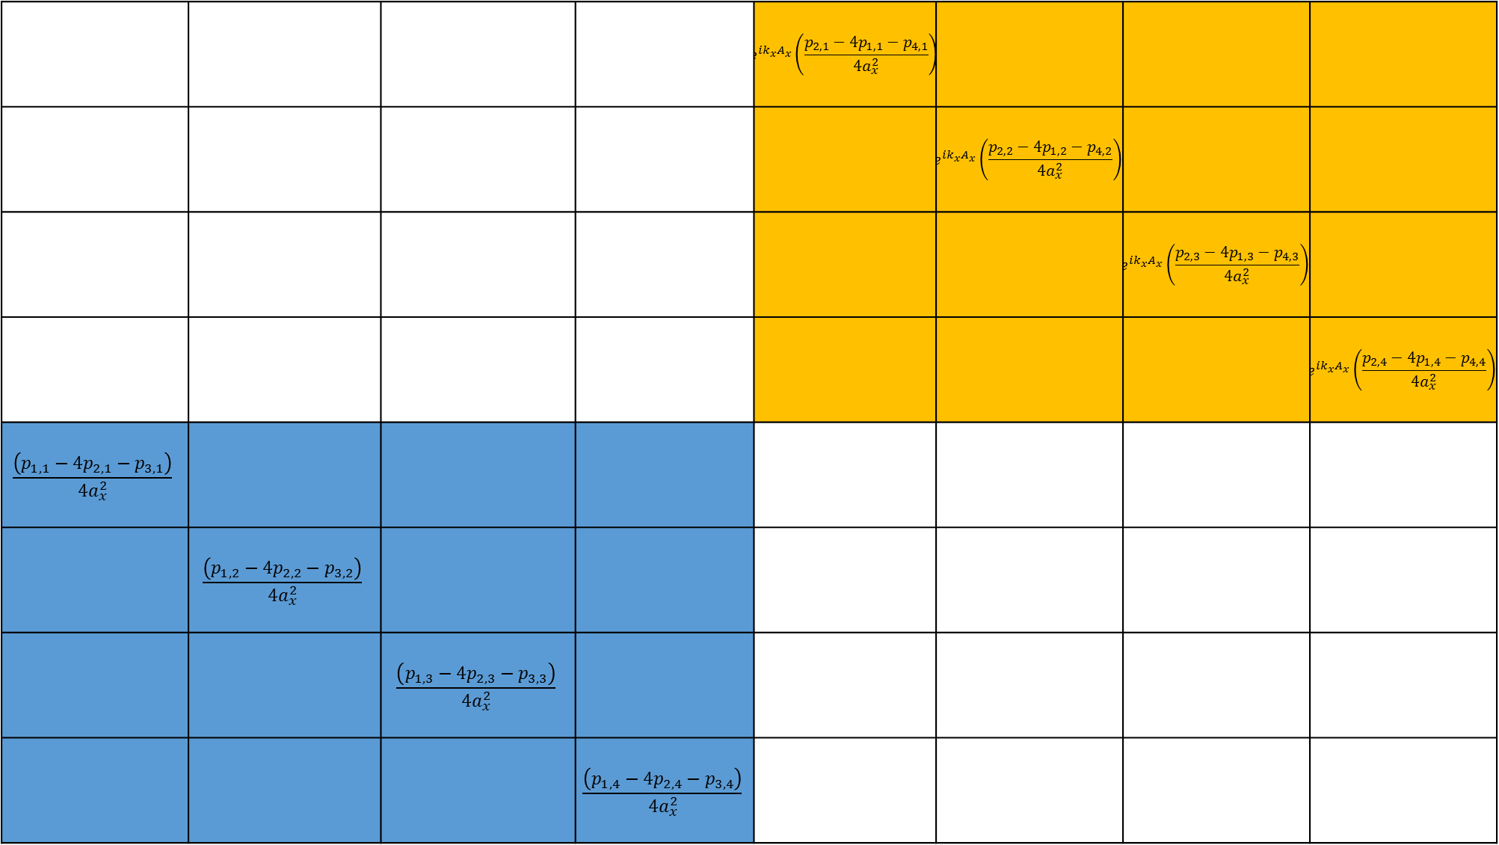
(1, 9)
(1, 10)
(1, 11)
(1, 12)
1, 13)
(1, 14)
(1, 15)
(1, 16)
 |  |  |  | $$e^{ik_{x}A_{x}}\left(\frac{p_{2,1}−{4p}_{1,1}−p_{4,1}}{{4a}_{x}^{2}}\right)$$
 |  |  |  |  | $$e^{ik_{x}A_{x}}\left(\frac{p_{2,2}−{4p}_{1,2}−p_{4,2}}{{4a}_{x}^{2}}\right)$$
 |  |  |  |  |  | $$e^{ik_{x}A_{x}}\left(\frac{p_{2,3}−{4p}_{1,3}−p_{4,3}}{{4a}_{x}^{2}}\right)$$
 |  |  |  |  |  |  | $$e^{ik_{x}A_{x}}\left(\frac{p_{2,4}−{4p}_{1,4}−p_{4,4}}{{4a}_{x}^{2}}\right)$$
$$\frac{\left(p_{1,1}−{4p}_{2,1}−p_{3,1}\right)}{{4a}_{x}^{2}}$$
 | $$\frac{\left(p_{1,2}−{4p}_{2,2}−p_{3,2}\right)}{{4a}_{x}^{2}}$$
 |  | $$\frac{\left(p_{1,3}−{4p}_{2,3}−p_{3,3}\right)}{{4a}_{x}^{2}}$$
 |  |  | $$\frac{\left(p_{1,4}−{4p}_{2,4}−p_{3,4}\right)}{{4a}_{x}^{2}}$$
(2, 9)
(2, 10)
(2, 11)
(2, 12)
(2, 13)
(2, 14)
(2, 15)
(2, 16)
(3, 9)
(3, 10)
(3, 11)
(3, 12)
(3, 13)
(3, 14)
(3, 15)
(3, 16)
(4, 9)
(4, 10)
(4, 11)
(4, 12)
(4, 13)
(4, 14)
(4, 15)
(4, 16)
(5, 9)
(5, 10)
(5, 11)
(5, 12)
(5, 13)
(5, 14)
(5, 15)
(5, 16)
(6, 9)
(6, 10)
(6, 11)
(6, 12)
(6, 13)
(6, 14)
(6, 15)
(6, 16)
(7, 9)
(7, 10)
(7, 11)
(7, 12)
(7, 13)
(7, 14)
(7, 15)
(7, 16)
(8, 9)
(8, 10)
(8, 11)
(8, 12)
(8, 13)
(8, 14)
(8, 15)
(8, 16)

Slide 3
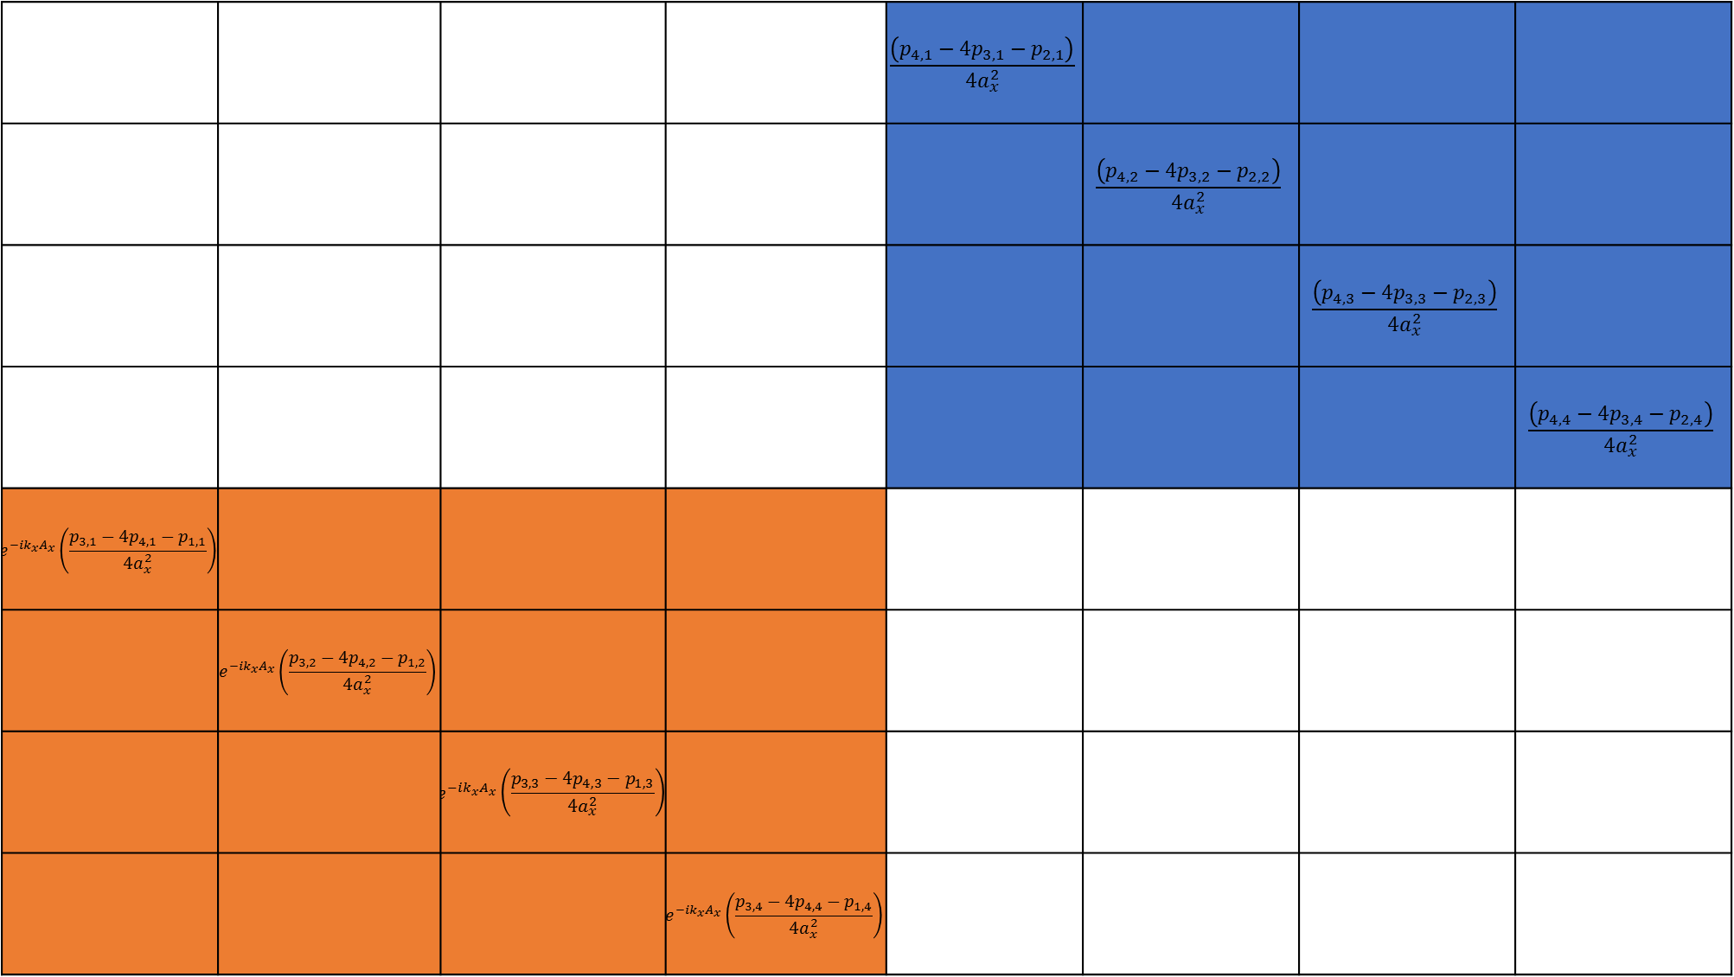
(9, 1)
(9, 2)
(9, 3)
(9, 4)
(9, 5)
(9, 6)
(9, 7)
(9, 8)
 |  |  |  | $$\frac{\left(p_{4,1}−{4p}_{3,1}−p_{2,1}\right)}{{4a}_{x}^{2}}$$
 |  |  |  |  | $$\frac{\left(p_{4,2}−{4p}_{3,2}−p_{2,2}\right)}{{4a}_{x}^{2}}$$
 |  |  |  |  |  | $$\frac{\left(p_{4,3}−{4p}_{3,3}−p_{2,3}\right)}{{4a}_{x}^{2}}$$
 |  |  |  |  |  |  | $$\frac{\left(p_{4,4}−{4p}_{3,4}−p_{2,4}\right)}{{4a}_{x}^{2}}$$
$$e^{−ik_{x}A_{x}}\left(\frac{p_{3,1}−{4p}_{4,1}−p_{1,1}}{{4a}_{x}^{2}}\right)$$
 | $$e^{−ik_{x}A_{x}}\left(\frac{p_{3,2}−{4p}_{4,2}−p_{1,2}}{{4a}_{x}^{2}}\right)$$
 |  | $$e^{−ik_{x}A_{x}}\left(\frac{p_{3,3}−{4p}_{4,3}−p_{1,3}}{{4a}_{x}^{2}}\right)$$
 |  |  | $$e^{−ik_{x}A_{x}}\left(\frac{p_{3,4}−{4p}_{4,4}−p_{1,4}}{{4a}_{x}^{2}}\right)$$
(10, 1)
(10, 2)
(10, 3)
(10, 4)
(10, 5)
(10, 6)
(10, 7)
(10, 8)
(11, 1)
(11, 2)
(11, 3)
(11, 4)
(11, 5)
(11, 6)
(11, 7)
(11, 8)
(12, 1)
(12, 2)
(12, 3)
(12, 4)
(12, 5)
(12, 6)
(12, 7)
(12, 8)
(13, 1)
(13, 2)
(13, 3)
(13, 4)
(13, 5)
(13, 6)
(13, 7)
(13, 8)
(14, 1)
(14, 2)
(14, 3)
(14, 4)
(14, 5)
(14, 6)
(14, 7)
(14, 8)
(15, 1)
(15, 2)
(15, 3)
(15, 4)
(15, 5)
(15, 6)
(15, 7)
(15, 8)
(16, 1)
(16, 2)
(16, 3)
(16, 4)
(16, 5)
(16, 6)
(16, 7)
(16, 8)

Slide 4

(9, 9)
(9, 10)
(9, 11)
(9, 12)
(9, 13)
(9, 14)
(9, 15)
(9, 16)
$$p_{3,1}\left(\frac{2}{a_{x}^{2}}+\frac{2}{a_{y}^{2}}\right)$$ | $$−\frac{p_{3,1}}{a_{y}^{2}}$$ |  | $$−e^{ik_{y}A_{y}}\left(\frac{p_{3,1}}{a_{y}^{2}}\right)$$ | $$\frac{\left(p_{2,1}−{4p}_{3,1}−p_{4,1}\right)}{{4a}_{x}^{2}}$$
$$−\frac{p_{3,2}}{a_{y}^{2}}$$ | $$p_{3,2}\left(\frac{2}{a_{x}^{2}}+\frac{2}{a_{y}^{2}}\right)$$ | $$−\frac{p_{3,2}}{a_{y}^{2}}$$ |  |  | $$\frac{\left(p_{2,2}−{4p}_{3,2}−p_{4,2}\right)}{{4a}_{x}^{2}}$$
 | $$−\frac{p_{3,3}}{a_{y}^{2}}$$ | $$p_{3,3}\left(\frac{2}{a_{x}^{2}}+\frac{2}{a_{y}^{2}}\right)$$ | $$−\frac{p_{3,3}}{a_{y}^{2}}$$ |  |  | $$\frac{\left(p_{2,3}−{4p}_{3,3}−p_{4,3}\right)}{{4a}_{x}^{2}}$$
$$−e^{−ik_{y}A_{y}}\left(\frac{p_{3,4}}{a_{y}^{2}}\right)$$ |  | $$−\frac{p_{3,4}}{a_{y}^{2}}$$ | $$p_{3,4}\left(\frac{2}{a_{x}^{2}}+\frac{2}{a_{y}^{2}}\right)$$ |  |  |  | $$\frac{\left(p_{2,4}−{4p}_{3,4}−p_{4,4}\right)}{{4a}_{x}^{2}}$$
$$\frac{\left(p_{1,1}−{4p}_{4,1}−p_{3,1}\right)}{{4a}_{x}^{2}}$$ |  |  |  | $$p_{4,1}\left(\frac{2}{a_{x}^{2}}+\frac{2}{a_{y}^{2}}\right)$$ | $$−\frac{p_{4,1}}{a_{y}^{2}}$$ |  | $$−e^{ik_{y}A_{y}}\left(\frac{p_{4,1}}{a_{y}^{2}}\right)$$
 | $$\frac{\left(p_{1,2}−{4p}_{4,2}−p_{3,2}\right)}{{4a}_{x}^{2}}$$ |  |  | $$−\frac{p_{4,2}}{a_{y}^{2}}$$ | $$p_{4,2}\left(\frac{2}{a_{x}^{2}}+\frac{2}{a_{y}^{2}}\right)$$ | $$−\frac{p_{4,2}}{a_{y}^{2}}$$
 |  | $$\frac{\left(p_{1,3}−{4p}_{4,3}−p_{3,3}\right)}{{4a}_{x}^{2}}$$ |  |  | $$−\frac{p_{4,3}}{a_{y}^{2}}$$ | $$p_{4,3}\left(\frac{2}{a_{x}^{2}}+\frac{2}{a_{y}^{2}}\right)$$ | $$−\frac{p_{4,3}}{a_{y}^{2}}$$
 |  |  | $$\frac{\left(p_{1,4}−{4p}_{4,4}−p_{3,4}\right)}{{4a}_{x}^{2}}$$ | $$−e^{−ik_{y}A_{y}}\left(\frac{p_{4,4}}{a_{y}^{2}}\right)$$ |  | $$−\frac{p_{4,4}}{a_{y}^{2}}$$ | $$p_{4,4}\left(\frac{2}{a_{x}^{2}}+\frac{2}{a_{y}^{2}}\right)$$
(10, 9)
(10, 10)
(10, 11)
(10, 12)
(10, 13)
(10, 14)
(10, 15)
(10, 16)
(11, 9)
(11, 10)
(11, 11)
(11, 12)
(11, 13)
(11, 14)
(11, 15)
(11, 16)
(12, 9)
(12, 10)
(12, 11)
(12, 12)
(12, 13)
(12, 14)
(12, 15)
(12, 16)
(13, 9)
(13, 10)
(13, 11)
(13, 12)
(13, 13)
(13, 14)
(13, 15)
(13, 16)
(14, 9)
(14, 10)
(14, 11)
(14, 12)
(14, 13)
(14, 14)
(14, 15)
(14, 16)
(15, 9)
(15, 10)
(15, 11)
(15, 12)
(15, 13)
(15, 14)
(15, 15)
(15, 16)
(16, 9)
(16, 10)
(16, 11)
(16, 12)
(16, 13)
(16, 14)
(16, 15)
(16, 16)

